Slide 1
Order Routing Impact on Information Leakage Data Wrangling Intro
Kevin Ramlal, Thomas Moore, Junjie Rao, Weipeng Shao

Slide 2
Motivation
The focus of our project is to study how routing decisions impact information leakage. Specifically we are looking at the decision between “creating” the NBB/NBO on one venue’s limit-order book versus “joining” the NBB/NBO on another venue’s LOB that already has NBB/NBO orders.
From the goal of the project – it’s obvious that we need DATA! Specifically, we need to be able to identify instances of when one makes the decision to either join or create at the NBBO.
In this presentation we hope to outline how we go about this identification process.

Slide 3
Data source
We use TAQ data downloaded from WRDS.
Specifically we use two types of files:
1. Millisecond Consolidated Quote File
2. Millisecond Consolidate Trade File
For more information on these files see the NASDAQ spec found here
https://www.nyse.com/market-data/historical/daily-taq

Slide 4
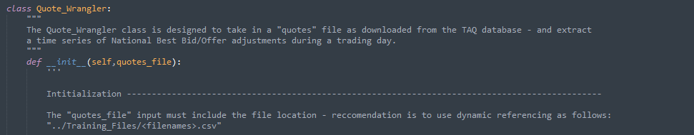
Technology
As we are in our initial stages of investigation – we make extensive use of Python and Jupyter Notebooks. As we progress, we may use C++ for faster computation. For team collaboration, we make use of a private Github repo.
Currently, we are using a core python file that takes the TAQ data, and creates two classes, a Quote_Wrangler class and a Trade_Wrangler class. These classes serve as the foundation for our data exploration, with built-in methods for finding the NBBO, and identifying cases of joining/creating.

Slide 5
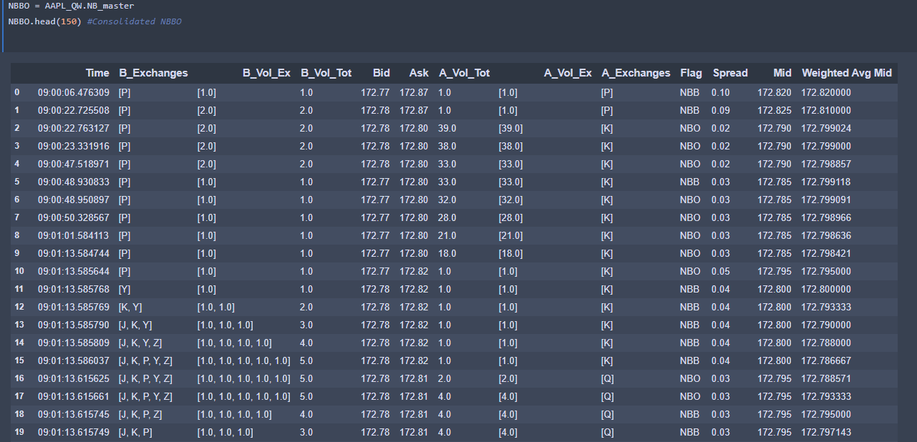
Extracting the NBBO
The NB_master method in the Quote Wrangler class extracts the consolidated NBBO. This table serves as a foundation for our analysis in this project.

Slide 6
Extracting the NBBO contd
Columns:
Time: datetime object that goes down to the microsecond
B_Exchanges: List of individual exchange codes that have quotes at the NBB
B_Vol_Ex: List of volumes per exchange (in same order as B_Exchanges) at the NBB
B_Vol_Tot: Total Volume at the NBB
Bid: NBB
Ask, A_Vol_Tot, A_Vol_Ex, A_Exchanges: Equivalent to the above columns, except for the NBO
Flag: Either NBB/NBO. Specificies whether this line represents a change in the NBO or NBB (more on this in the next slide!)
Spread: Ask – Bid
Mid: (Ask + Bid) / 2
Weighted Avg Mid: A_Vol_Tot*Ask + B_Vol_Tot*Bid/ (A_Vol_Tot + B_Vol_Tot)

Slide 7
NBO/NBB Flag Explained
The Flag column takes on one of two values either NBB or NBO.
Taking a step back – every line in the NBBO table reflects one of four possible types of changes summarized below.
1. Change in the NBB Price. The actual Bid value changes (Flag = NBB)
2. Change in the Exchanges or Exchange Volume at the NBB. Note that the actual Bid price does not change in this case. (Flag = NBB)
3. Change in the NBO Price. The actual Ask value changes (Flag = NBO)
4. Change in the Exchanges or the Exchange Volume at the NBO. The actual Ask price does not change. (Flag = NBO)

Slide 8

IDENTIFYING JOINING AND CREATING
Using the information in the NBBO table we are able to extract cases of joining and creating. This is done using the cj_flagger method in the Quote Wrangler object.
Over the next few slides we will explain in detail how this is done.
Note that the concepts of joining/creating must be used in isolation of a “Flag” type. That is, we can identify cases of joining/creating at the NBB, AND we can identify cases of joining/creating at NBO.
Using the cj_flagger we must specific whether it is NBB or NBO and isolate accordingly.

Slide 9
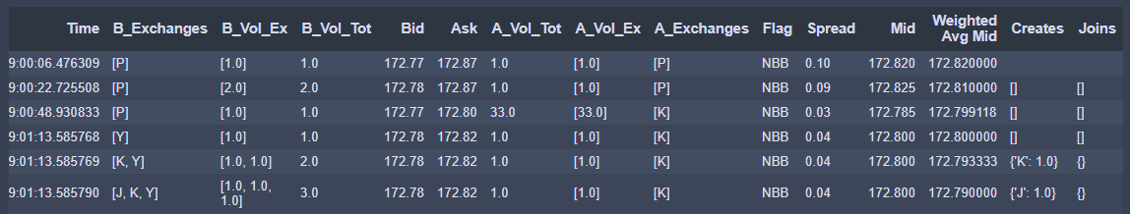
Creating
We assume we are working with NBB Creates/Joins.
Creating is when a limit order at the NBB is sent to an exchange that currently has NO orders at the NBB. Spotting this can be done by using the B_Exchanges and B_Vol_Exch columns.
In time 9:01:13.585768 – we have a NBB of 172.78, with exchange Y having posted a volume of 1.0.
In time 9:01.13.585769 – the NBB is still at 172.78, except now exchange K has posted a volume of 1.0. In this situation – the NBB was CREATED on exchange K. This exchange and volume is flagged under the Creates column which is a new column generated by the cj_flagger function.
Again in time 9:01.13.585790 – we see the NBB is created on exchange J with a volume of 1.0

Slide 10
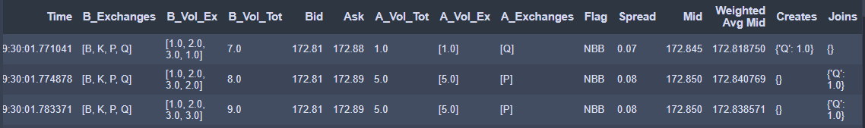
Joining
Joining is when a limit order at the NBB is sent to an exchange that currently has orders at the NBB. Spotting this can be done by using the B_Exchanges and B_Vol_Exch columns.
Note that in time 9:30:01.771041 – we have a NBB of 172.81, with exchanges B,K,P,Q posting a volume of 1.0, 2.0, 3.0, 1.0 respectively.
In time 9:30:01.774878 – the NBB is still at 172.78, except now exchange Q has increased their previous volume from 1.0 to 2.0 In this situation – the NBB was JOINED on exchange Q. This exchange and volume is flagged under the Joins column which is a new column generated by the cj_flagger function.
Again in time 9:30:0.783371 – we see the NBB is joined again on exchange Q with additional volume of 1.0

